Slide 1
guidelines for developing successful RADIOGENOMIC research teams
NCI The Cancer Genome Atlas (TCGA)
The Cancer Imaging Archive (TCIA)
Processes modeled on multi-year experience of following teams:
Brain: GBM & LGG - Breast: BRCA - Renal: KIRC - Ovarian: OV

Slide 2
Starting framework
Start expert team formation once pre-surgical tumor type TCIA image collection has reached statistically robust size of > 100 cases
Log/list inventory of scan types of each case available (e.g. CT type, MR pulse sequences, etc)
https://wiki.cancerimagingarchive.net/display/Public/Wiki
List/publish clinical data field available from TCGA Data Portal for that tumor type
https://tcga-data.nci.nih.gov/tcga/tcgaHome2.jsp

Slide 3
Next steps
Contact interested clinical image experts
Ask them to outreach to expert image reader colleagues known to them (~ a dozen or so)
Ask or suggest advisory colleagues with tumor relevant expertise in genetics, oncology, stats
Define governance/communication processes
T-con schedule; reading parameters; collegial and publication/authorship/citation understandings

Slide 4
Data acquisition processes
Team generates v.1 structured-reporting
CRF “feature set” pick-list with quantitative elements
Team constructs Visual Manual depicting each feature listed choice element
NCI CIP creates Wiki and Google-doc sites specific to team
Training set case-list created
sparing TCGA cases if possible

Slide 5
TCGA Breast Imaging Scoring Visual Guide v8
Example
Based on BI-RADS, but more granular

Slide 6
Example: Breast Feature List
1.1 Breast Observations – Extent
1.2 Breast Observations - Flag for extensive heterogeneous disease
1.3 Breast Observations - Fibroglandular
1.4 Breast Observations – Background
1.5 Breast Observations - Associated Features
1.6 Breast Observations – Select the Dominant Finding
2.1 Mass Observations – Breast Side
2.2 Mass Observations - Shape
2.3 Mass Observations - Internal Enhancement
2.4 Mass Observations - Clip in index lesion
2.5 Mass Observations - Dark Internal Septations
2.6 Mass Observations - Rim Enhancement
2.7 Mass Observations - Margin
2.8 Mass Observations – T2 Pattern
2.9 Mass Observations - Predominant T2 Signal Intensity
2.10 Mass Observations - T2 Peritumoral Edema
2.11 Mass Observations - Associated Nonmass Enhancement
3.1 Nonmass Observations - Internal Enhancement
3.2 Nonmass Observations – Distribution
4.1 Measurement – Measure the dominant finding

Slide 7
Example: 1.1 Breast Observations - Extent
Definitions:
Multifocal
More than one lesion but contained in the same quadrant
Within 3 clock-face positions (though not in conventional quadrant) e.g. 2 & 4 o’clock
Appropriate for breast conservation
Multicentric
More than one lesion which is noted in more than one quadrant, separated by > 3 clock-face positions, or ulikely to be appropriate for breast conservation.
Unicentric
One contiguous lesion

Slide 8
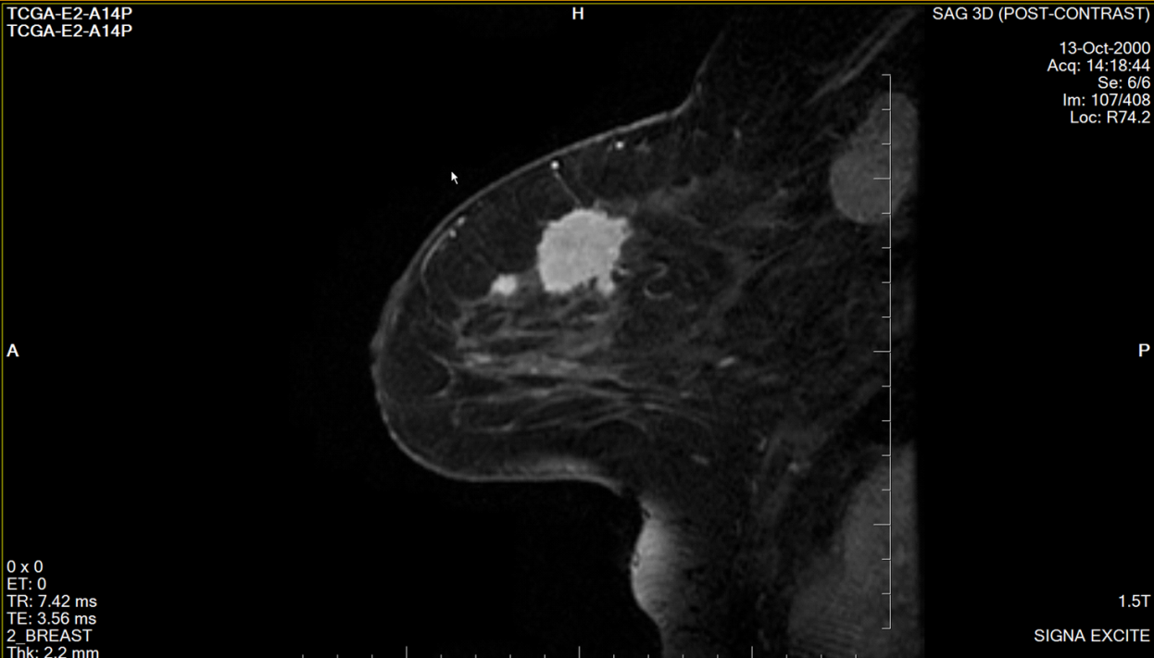
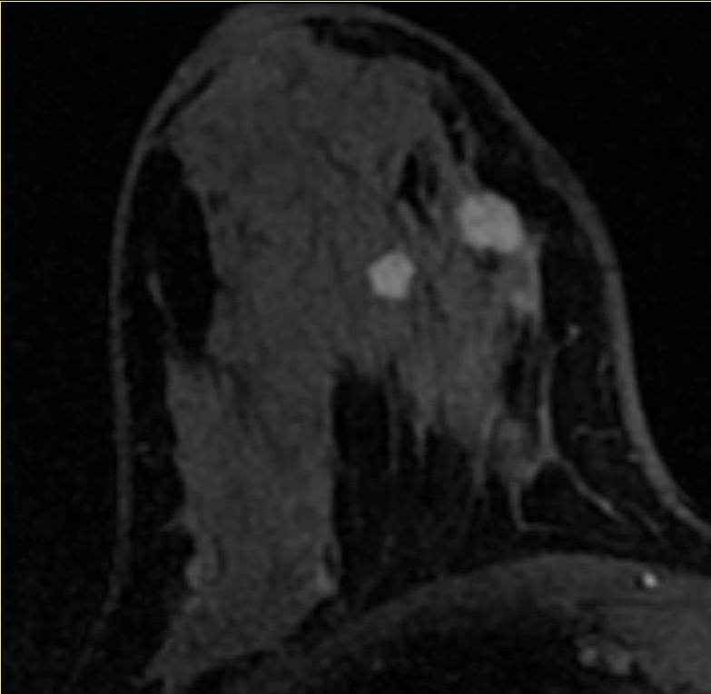
1.1 Breast Observations - Extent
Multifocal

Slide 9
NCI CIP helps team self-assign reading teams membership and monitor training progress
Schedule and specify reader training process
NCI CIP (or other) bio-informatician discusses/summarizes reader consistency/variation on training set for each feature
Feature culling occurs and repeat training as needed iteratively (v.2, 3, …etc)

Slide 10
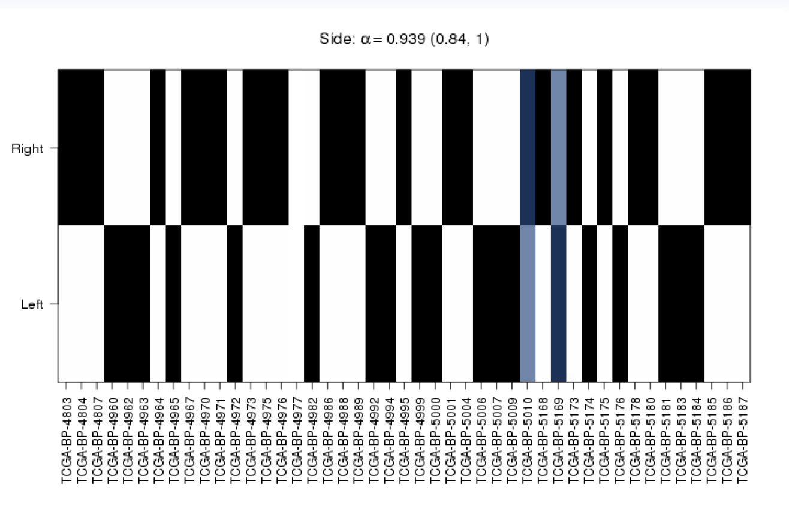
Reader Agreement Example: Klippendorf alpha Dr Erich Huang, NCI Bioinformatician

Slide 11
Case Reading Details
solicit radiologist expert reviewers
readers will be set up with an individual accounts on research image viewer (ePAD)
assign readers their assessment cases in batches
Data collected, discussed and QC’d while in process to remediate problems

Slide 12
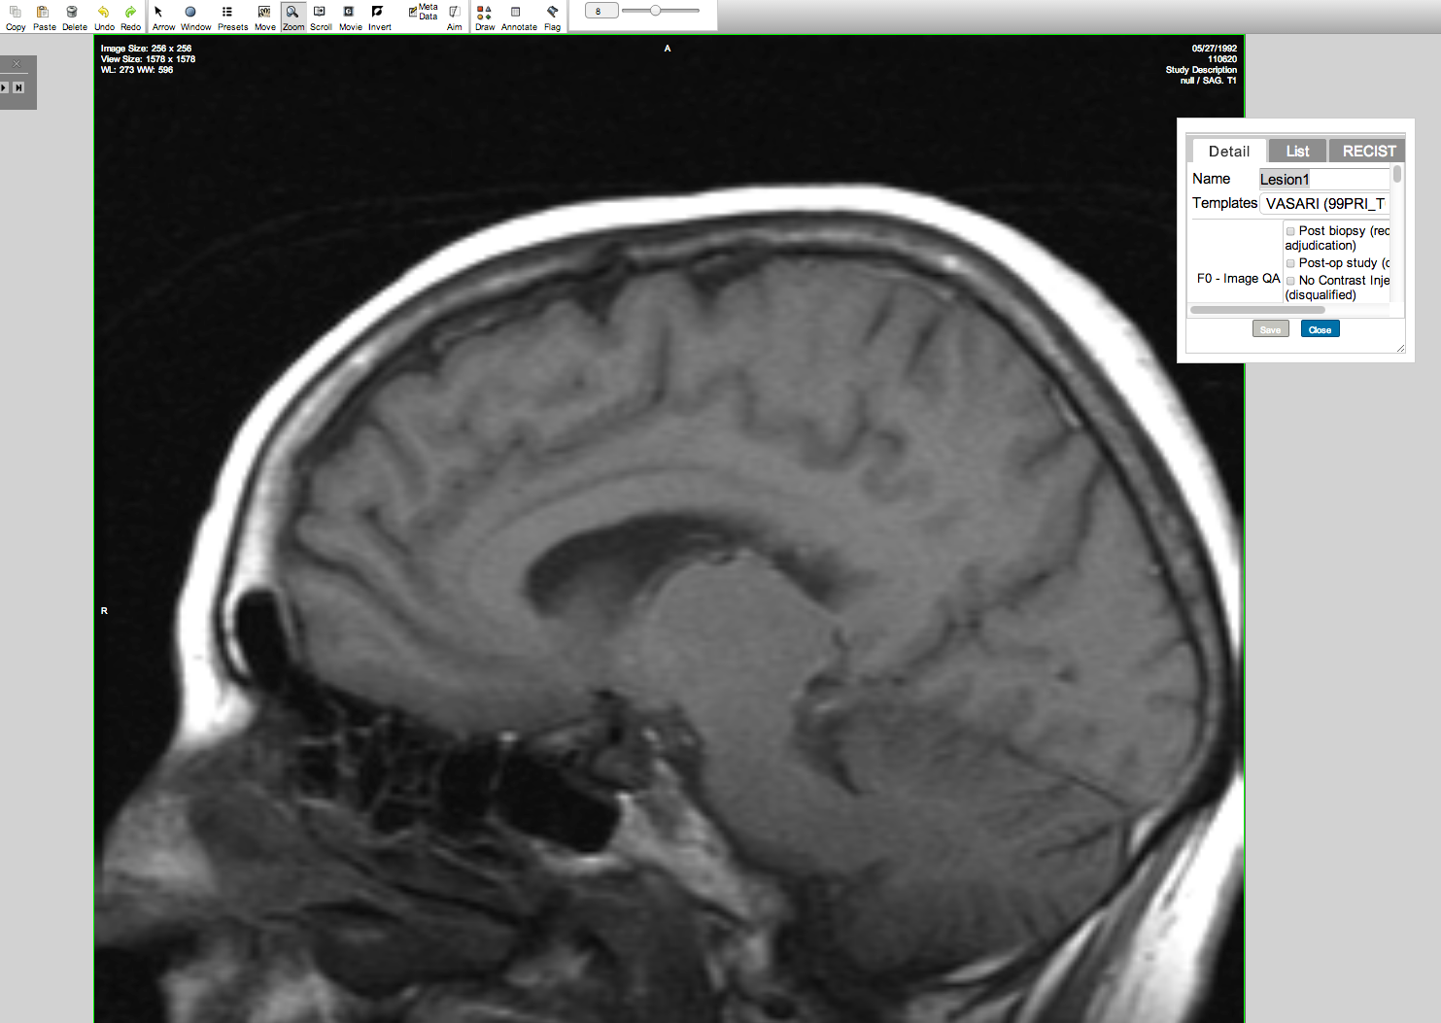
http://54.83.33.219/epad/
usr jaffe pwd lgg

Slide 13
More
Team defines size of each case reader cohort (3 or more as feasible)
Initiate reads on a limited number of test cases
Trouble-shoot by T-con discussions with minutes taken and provided by NCI
Final review by team of reader consistency on training set.
Perform re-training if necessary

Slide 14
Enhancing Visual Observations by Developing Quantitative Computation Methods
Proceeding from expert observations to quantitative computational methods/processes
Team chooses computational partner(s) to explore objective computational methods
e.g.: common computational approaches
Calculation of shape/boundary/gradient/texture properties with or without expert placed seed points (2D/3D)
Artificial intelligence and neural net methods that meld clinical/path data with found spatial tumor object properties

Slide 15
Research results harvesting
Abstract and paper submission planning with deadlines
Analytic approach discussed with team cross-disciplinary advisors
emphasis: TCGA ‘omic correlations, survival, etc

