Slide 1
TCGA Ovarian Imaging Scoring Visual Guide v2
TCGA Imaging Research Group

Slide 2
Feature List
1.1 Image QA – Disqualification Criteria
2.1 Peritoneal Disease – Presence
2.2 Peritoneal Disease - Calcifications
2.3 Peritoneal Disease – Locations of peritoneal disease (other than omentum)
3.1 Omentum – Omental Implant
3.2 Omentum – Shape of Omental Disease
4.1 Ascites – Ascites
4.2 Ascites – Ascites Size
5.1 Lymphadenopathy – Pathological Lymph Node Presence
5.2 Lymphadenopathy – Nodal Stations
6.1 Distant Metastases – Presence
6.2 Distant Metastases – Calcifications
6.3 Distant Metastases – Locations
7.1 Pleural Effusion - Presence
7.2 Pleural Effusion - Size
8.1 Ovarian Mass – Laterality
7.2 Ovarian Mass – Calcifications
7.3 Ovarian Mass - Thick Septations
7.4 Ovarian Mass – Internal Architecture
7.5 Ovarian Mass - Size

Slide 3
1.1 Image QA – Disqualification Criteria
Post Operative
Insufficient Imaging Available
No Contrast Injected

Slide 4
2.1 Peritoneal Disease - Presence
Yes
No

Slide 5
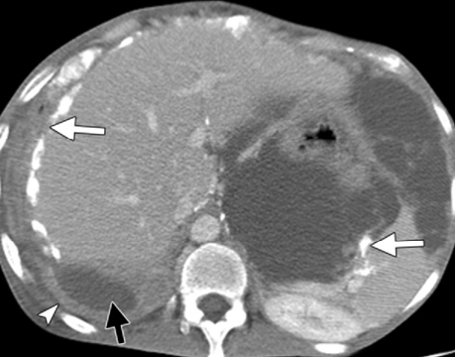
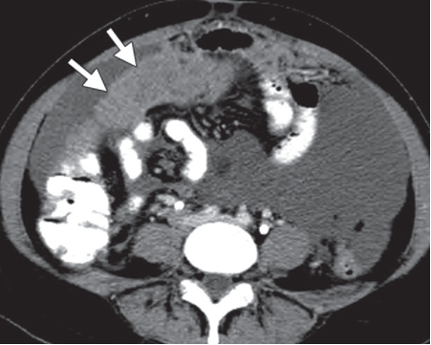
2.3 Peritoneal Disease - Calcifications
Present / Absent
Present
Absent

Slide 6
2.4 Peritoneal Disease – Locations of Peritoneal Disease (other than Omentum
Spleen / Left upper quadrant
Lesser sac
Liver / Right upper quadrant
Define-able mesenteric implant
Mesentery (including infiltration/tethering of the mesenteric root)
Paracolic gutters (left, right)
Pouch of Douglas
Question skipped automatically

Slide 7
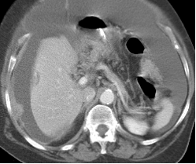
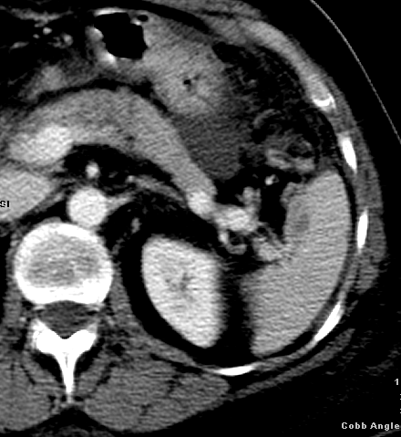
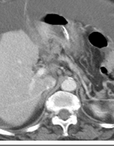
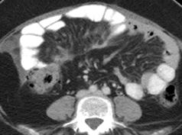
2.4 Peritoneal Disease – Locations of Peritoneal Disease (other than Omentum)
Liver/RUQ
Spleen/LUQ
GH ligament/Lesser Sac
Definable mesenteric
implant
Mesenteric infiltration
tethering
Paracolic gutters
(R, L, or both)

Slide 8
3.1Omentum – Omental Implant
Yes
No

Slide 9
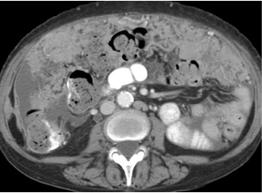
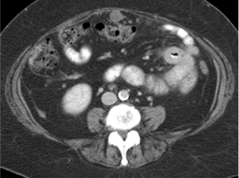
3.2 Omentum – Shape of Omental Disease
Predominantly Diffuse / Predominantly Nodular
Predominantly Diffuse
Predominantly Nodular

Slide 10
4.1 Ascites - Ascites
Present
Absent

Slide 11
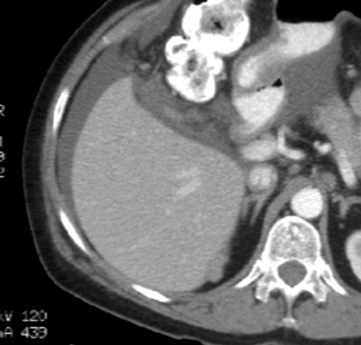
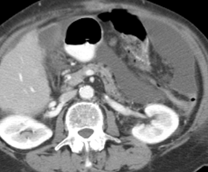
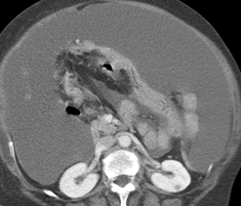
4.2 Ascites – Ascites Size
Trace/Small, Moderate/Large
Trace/Small
Moderate/Large

Slide 12
5.1 Lymphadenopathy – Pathological Lymph Node Presence
Present if SA dimension is above a cut-off below, or spiculated borders, or heterogenous attenuation (other than fatty hilum), or nodal clustering.
Mediastinal– over 1.0 cm
Internal mammary nodes -over 0.5 cm
Retroperitoneal - over 1 cm
Supradiaphragmatic - over 0.5 cm
Retrocrural - 0.5 cm
Porta hepatis/celiac axis/GH - over 1 cm
Portocaval node - over 1.5 cm in short axis or no longer cigar-shaped.
Pelvic nodes - over 0.8
Mesorectal and superior hemorrhoidal - over 0.5 cm
Inguinal nodes –over 1.5 cm

Slide 13
5.1 Lymphadenopathy – Pathological Lymph Node Presence
Yes
No

Slide 14
5.2 Lymphadenopathy – Nodal Stations
Thoracic (except retrocrural and supradiaphramgmatic)
Retrocrural
Supradiaphragmatic
Suprarenal Retroperitoneal
Infrarenal Retroperitoneal
Porta / Celiac / Gastrohepatic
Pelvic (common, external, internal iliac, and obturator)
Inguinal

Slide 15
6.1 Distant Metastases - Presence
Yes
No

Slide 16
6.2 Distant Metastases - Calcifications
Yes
No

Slide 17
6.3 Distant Metastases - Locations
Liver
Spleen
Lung
Pleura
Other

Slide 18
6.3 Distant Metastases - Locations
Liver

Slide 19
7.1 Pleural Effusion - Presence
Yes
No

Slide 20
7.2 Pleural Effusion - Size
Small, Moderate, Large
Small
Moderate
Large

Slide 21
8.1 Ovarian Mass - Laterality
Right
Left
Bilateral

Slide 22
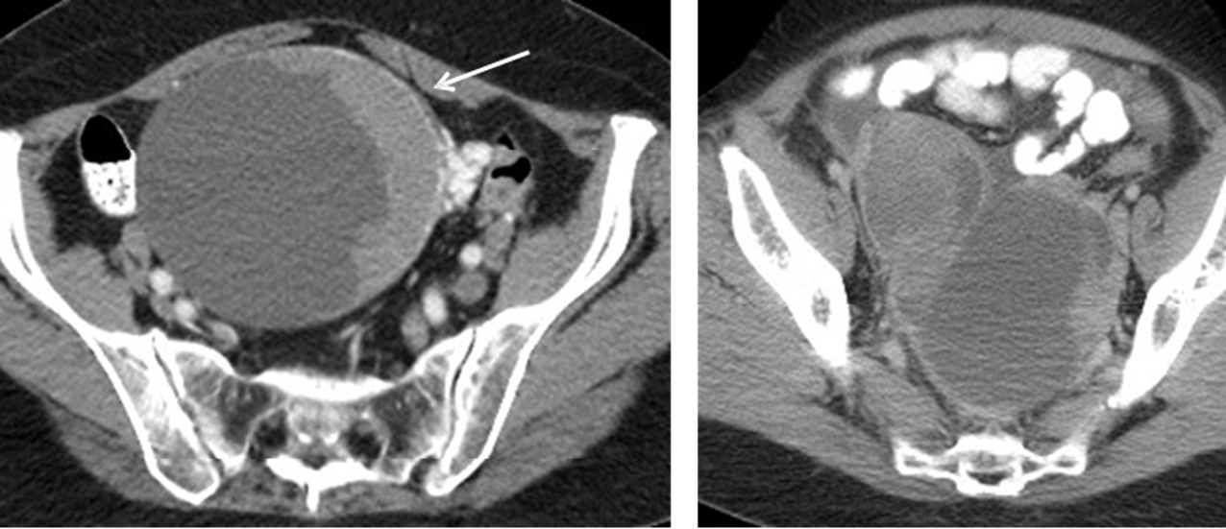
8.2 Ovarian Mass - Calcifications
Present / Absent
Present
Absent

Slide 23
8.3 Ovarian Mass – Thick Septations
Present / Absent
Thick Septations (>3mm)

Slide 24
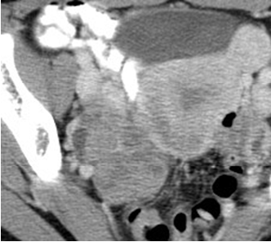
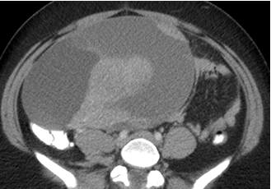
8.4 Ovarian Mass – Internal Architecture
Predominantly Cystic / Predominantly Solid / Mixed
Predominantly Cystic
Predominantly Solid
Mixed

Slide 25
8.5 Ovarian Mass – Size
Measure the maximum mass diameter in the axial plane with the ruler tool.

