Slide 1
http://cancerimagingarchive.net
Crowds Cure Cancer: Annotating data from
Justin Kirby – justin.kirby@nih.gov
Frederick National Laboratory for Cancer Research
Leidos Biomedical Research, Inc.
Informatics in Cancer Imaging (ICI) Team
Support to: Cancer Imaging Program/DCTD/NCI
Citizen Science WG Meeting: Oct 2018

Slide 2
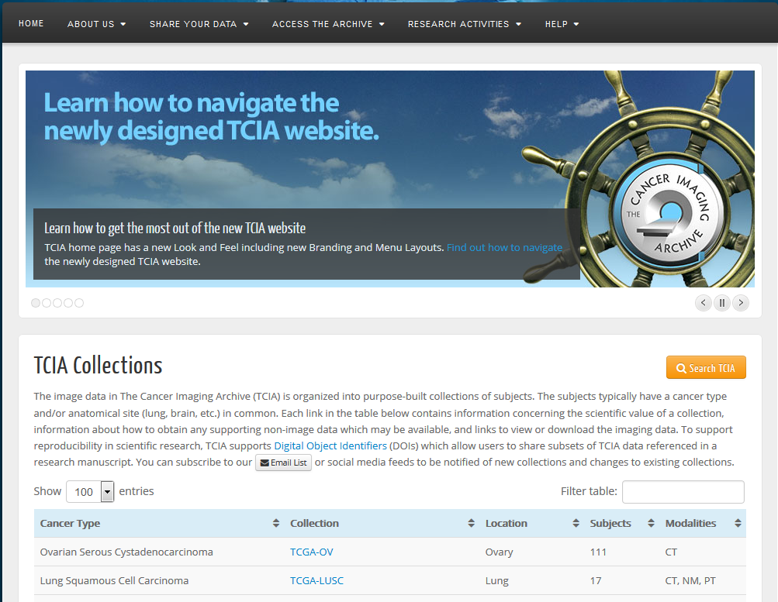
The Cancer Imaging Archive: Brief intro
87 data sets (20 terabytes) consisting of 41,000 subjects (33 million radiology images)
Covers radiology modalities (CT/MR/PET/RT) and digitized pathology slides
Wide variety of cancers + phantoms
Patient populations vary from a handful to >26,000 (NLST)
Many have associated meta-data
Demographics/outcomes/therapy
Radiologist expert and automated computational analyses (segmentations, features)
‘Omics ties to GDC/TCGA, CPTAC, and GEO
http://www.cancerimagingarchive.net

Slide 3
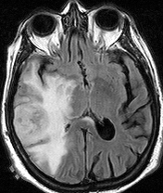
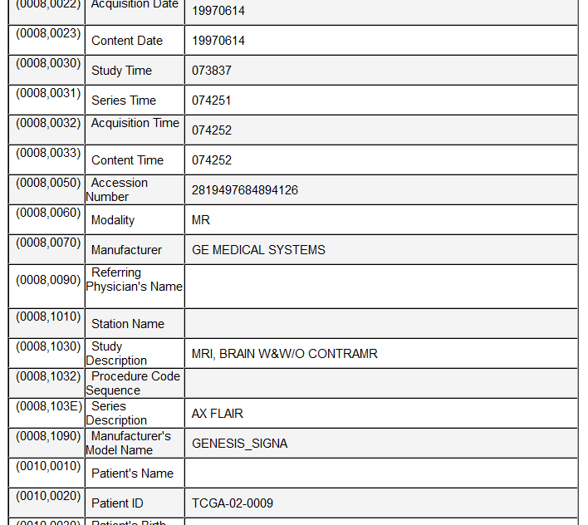
Tackling the de-identification challenge
PHI can appear in hundreds of places in DICOM
Dates
Identifiers
Descriptions
Potential legal risks are a significant barrier to data sharing for research

Slide 4
TCIA services (not just software)
Relieves PI of majority of data sharing burden/risks
Data hosting with >99% uptime
De-identification using pre-configured RSNA’s Clinical Trials Processor (CTP) and DICOM PS 3.15 Annex E standards
Multi-tiered QC process inspects both DICOM headers and pixels for PHI and integrity of data set
Phone/email support available for end users and submitters
Extensive documentation throughout the site
Exposure to a large community of researchers
Increase visibility of your work, get more citations!

Slide 5
TCIA Services: Staffing
TCIA Management at UAMS
Prior, Smith
Infrastructure Support
Smith, Nolan, Dobbins, Tarbox, Tobler, Frund, Utecht, Brown
Data Collection: Programs
Bennett, Berryman, Billelo
Data Collection: Research Collections
Jarosz, Stockton, Honomichl
Data Collection: Pathology
Sharma, Birminam, TBD
APOLLO (clinical/backlog)
Levine, Angelus, TBD
Clinical Trials
TBD
CIP ICI Management
Freymann
Kirby
Sullivan
Cordeiro
Hill

Slide 6
Organization of TCIA ecosystem
The Cancer Imaging Archive
Data Collection Center
Data Access
Data Analysis Centers
3rd party web sites or tools which connect to TCIA’s API or mirror its data
Tools and staffing to support data collection, curation, and de-identification
Browse (home page)
Filter/Search (Data Portal)
REST API
Analysis Data

Slide 7
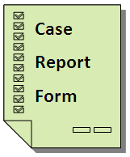
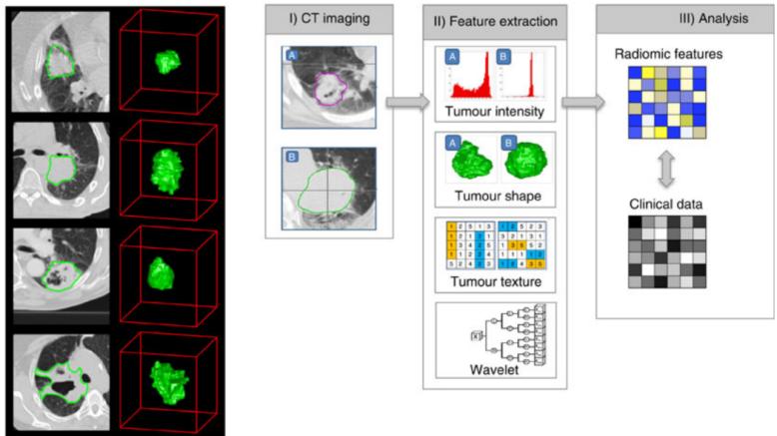
Data Collection Center: Publish Your Data
Primary Data (radiology, pathology, clinical, etc)
Analysis Results (derived from primary data)
Image credit: Hugo Aerts

Slide 8
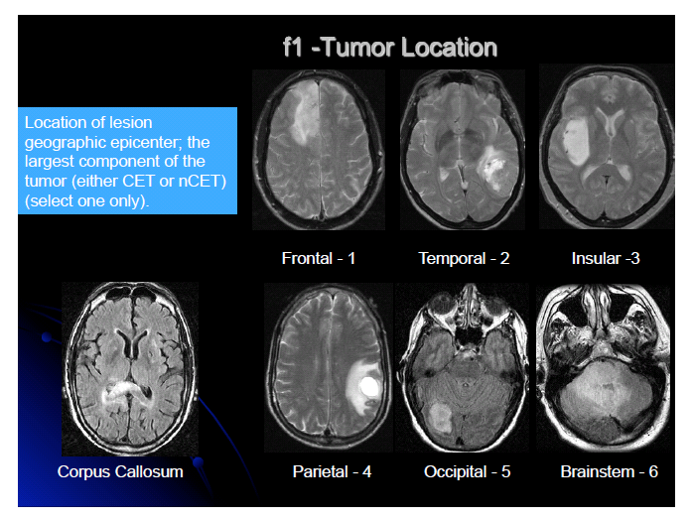
Data Collection Center: Publishing data in addition to manuscripts
Data citations for both primary and analysis data to enable reproducible research
Primary Data Citation (TCIA images used for study)
Scarpace, L., Mikkelsen, T., Cha, soonmee, Rao, S., Tekchandani, S., Gutman, D., … Pierce, L. J. (2016). Radiology Data from The Cancer Genome Atlas Glioblastoma Multiforme [TCGA-GBM] collection. The Cancer Imaging Archive. http://doi.org/10.7937/K9/TCIA.2016.RNYFUYE9
Analysis Dataset Citation (derived image features)
Gutman DA, Cooper LA, Hwang SN, Holder CA, Gao J, Aurora TD, Dunn WD Jr, Scarpace L, Mikkelsen T, Jain R, Wintermark M, Jilwan M, Raghavan P, Huang E, Clifford RJ, Mongkolwat P, Kleper V, Freymann J, Kirby J, Zinn PO, Moreno CS, Jaffe C, Colen R, Rubin DL, Saltz J, Flanders A, Brat DJ. (2014). MR Imaging Predictors of Molecular Profile and Survival: Multi-institutional Study of the TCGA Glioblastoma Data Set. The Cancer Imaging Archive. http://doi.org/10.7937/K9/TCIA.2014.4HTXYRCN
Publication Citation (cites specific data used)
MR imaging predictors of molecular profile and survival: multi-institutional study of the TCGA glioblastoma data set. Radiology. 2013 May;267(2):560-9. doi: 10.1148/radiol.13120118. Epub 2013 Feb 7. PubMed PMID: 23392431; PubMed Central PMCID: PMC3632807.
Notes:
Provide DOIs to collections and meta-collections (article’s analysis)
Publication can refer to the specific data sets used via the DOIs in the data citations
Currently working with NLM, collaborating with Nature Scientific Data and other publications

Slide 9
Data Descriptor Journals
Journal | Recommended Repositories
Nature Scientific Data | https://www.nature.com/sdata/policies/repositories#imaging
Medical Physics | http://aapm.onlinelibrary.wiley.com/hub/journal/10.1002/(ISSN)2473-4209/about/author-guidelines.html (see section 13-Medical Physics Dataset Articles)
Elsevier Data in Brief | http://www.elsevier.com/authors/author-services/research-data/data-base-linking/supported-data-repositories#Health
PLOS ONE | http://journals.plos.org/plosone/s/data-availability#loc-recommended-repositories
Research Data Support | https://www.springernature.com/gp/authors/research-data-policy/repositories-bio/12327160
Publish detailed descriptions about how to use your TCIA data to gain academic credit (publication/citations) in addition to the novel scientific findings you might publish in traditional journals.

Slide 10
Researchers want to share data – 38 data set queue
Program Data Sets | Notes
TCGA | 2 collection//sites
CPTAC | 9 cancer types, 14 sites
Exceptional Responders | 24 of 58 subjects remaining
Immunotherapy | 2 cancer types
PDX mouse | Not started
NCTN integration | RTOG 0617 pilot in process
QIN ECOG-ACRIN | 10 trials
Community Proposed Data Sets
GBM-DSC-MRI-DRO ASCC TNM Consensus Colorectal Liver Metastases QIN-BREAST-02 MyelomaTT3a Low Dose CT Liver Metastases Lung Fused-CT-Pathology HNSCC Oropharyngeal Radiomics OPC-Radiomics Oropharynx Phantoms HNSCC 3D CT RT MSK Pancreatic Cancer Repository

Slide 11
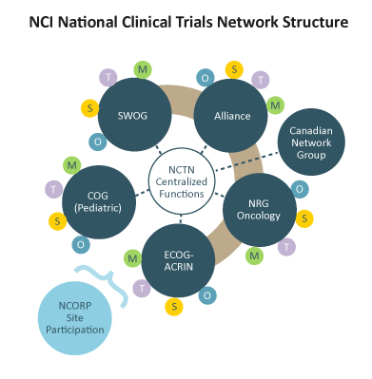
New funding to collect imaging from NCTN
Clinical
Imaging

Slide 12
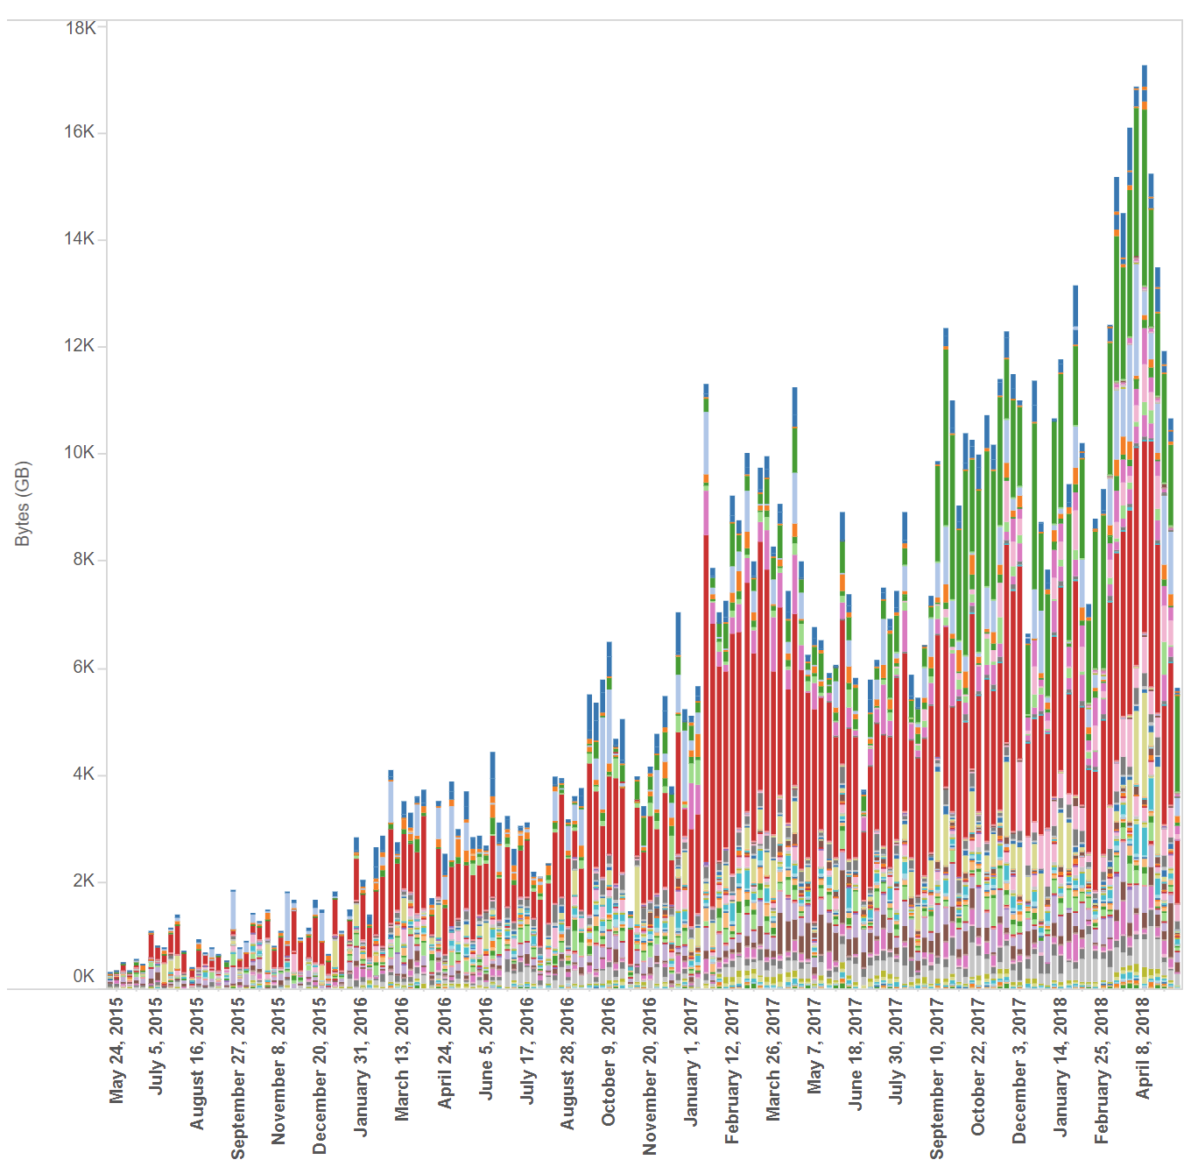
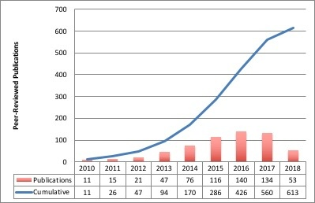
A significantly growing community!
38 incoming data sets in varying stages of curation
Over 10,000 active users per month
Up from ~3,000/month in 2015
Downloads of 40-50TB per month
Up from ~2TB/month in 2015
613 publications based on TCIA data
134 new publications in 2017

Slide 13
Crowds Cure Cancer: The motivation
Continued growth: Engage researchers outside the medical community
Computer science researchers often lack disease understanding or sufficient contact with medical experts
Labeling basic information in the images such as tumor locations to create “training data” can enable others to apply new methods to our data
TCIA has this kind of annotation for some data sets, but not all
Performing such annotations/labeling using a small number of radiologists is extremely time consuming and expensive

Slide 14
Stay tuned!

Slide 15
TCIA Acknowledgements
University of Arkansas
Dr. Fred Prior
Dr. Lawrence Tarbox
Kirk Smith
Bill Bennett
Tracy Nolan
Julie Frund
Sean Berryman
Dwayne Dobbins
Quasar Jarosz
Jeff Tobler
Sonya Utecht
Diana Stockton
Betty Levine
Erica Bilello
Geri Blake
Robert Brown
Frederick National Laboratory
for Cancer Research (FNLCR)
John Freymann
Justin Kirby
Brenda Fevrier-Sullivan
Pam Angelus
Carl Jaffe
Luis Cordeiro
Craig Hill
Emory University
Dr. Ashish Sharma
Ryan Birmingham
NBIA Team (NCI/FNLCR/Ellumen)
Ed Helton
Ulli Wagner
Scott Gustafson
Qinyan Pan
Russ Rieling
Carolyn Klinger
Martin Lerner
Tin Tran
Contractor
John Perry
Leidos Biomedical Research, Contract 16X011 for NCI, Maintenance and Extension of The Cancer Imaging Archive (TCIA ) (Prior)

Slide 16
Crowds Cure Cancer
October 1, 2018
Jayashree Kalpathy-Cramer

Slide 17
Agenda
Background
Collaborators
System Development
General impressions from RSNA of the experiment
Feedback from participants
Current status/results
Features to be added
Next steps

Slide 18
Background
Annotated data is key to improving performance of machine learning algorithms
Inter-rater agreement, even among experts, can be less than optimal
Helpful to have multiple annotations per case
Getting annotations is expensive
Hypothesis: crowd-sourced annotations, even derived from non-experts, can be used for machine learning

Slide 23
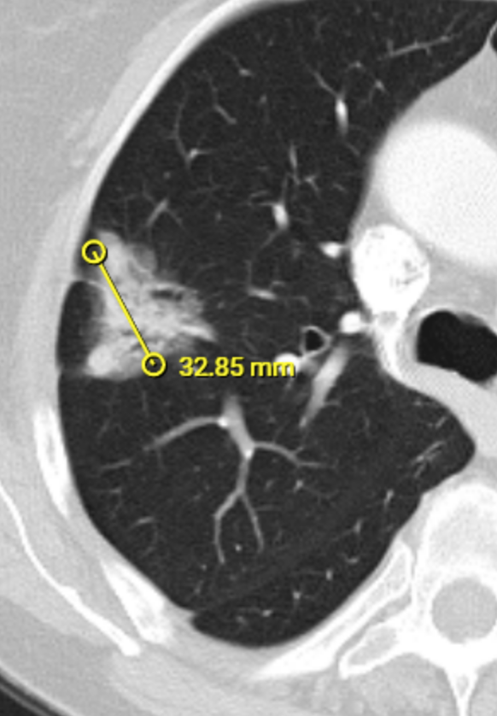
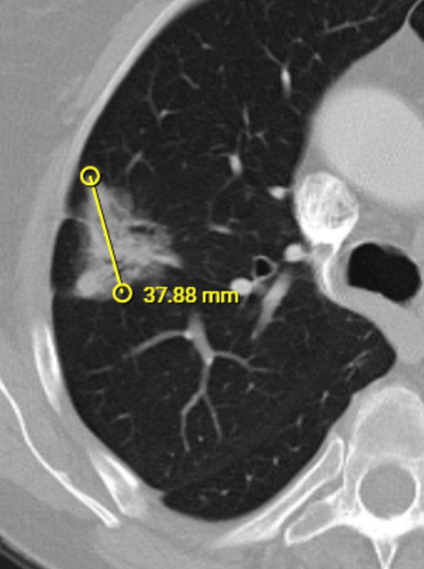

Slide 24
Collaborators
Erik Ziegler/Gordon Harris (OHIF/MGH/ITCR)
Steve Pieper (ITCR)
Lawrence Tarbox, Jeff Tobler, Fred Prior (UAMS/ITCR)
Ashish Sharma (Emory/ITCR)
Jayashree Kalpathy-Cramer/Artem Mamonov (MGH/ITCR)
Justin Kirby, Brenda Fevrier-Sullivan, John Freyman (FNL)
Erich Huang, Paula Jacobs (NCI)
RSNA (Informatics)

Slide 25
System Architecture
TCIA
Used images with known “truth” from TCGA studies/Carl Jaffe
Azure VM
Cornerstone Viewer
Lightweight version, mobile friendly!!
Chronicle DB (CouchDB) backend
DICOM aware!
Registration system
Logic for next case
JS/D3 for results (in progress)
Charts
Summary tables

Slide 26
General Impressions
Overall seemed to be a success
Many participants ended up spending more time than planned
Viewer was responsive
No major complaints about system performance
Results are (very) promising

Slide 27
Logistics
Better location?
Near case of the day
Coffee, water, cookies, chocolate
Wipes or alcohol wash for hands
Integration with RSNA app

Slide 28
Sociology
Leaderboard needs to be prominently displayed
Maybe award stars?

Slide 29
Annotators
Over 250 signed up
211 had at least 1 annotation
112 were radiologists
Selected
Liver: 189
Lung: 211
Renal: 165
Ovarian: 133
Selected
4: 120
3: 27
2: 29
1: 78

Slide 30
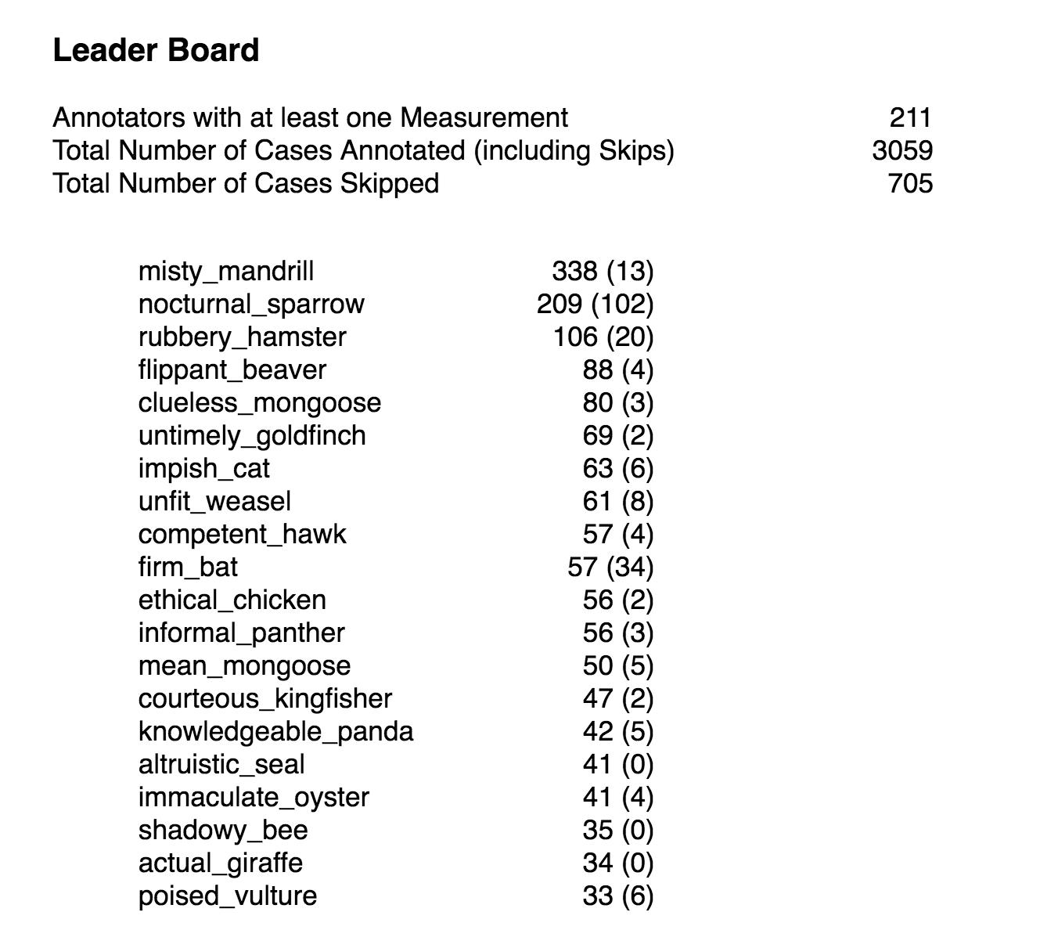
Dashboard

Slide 31
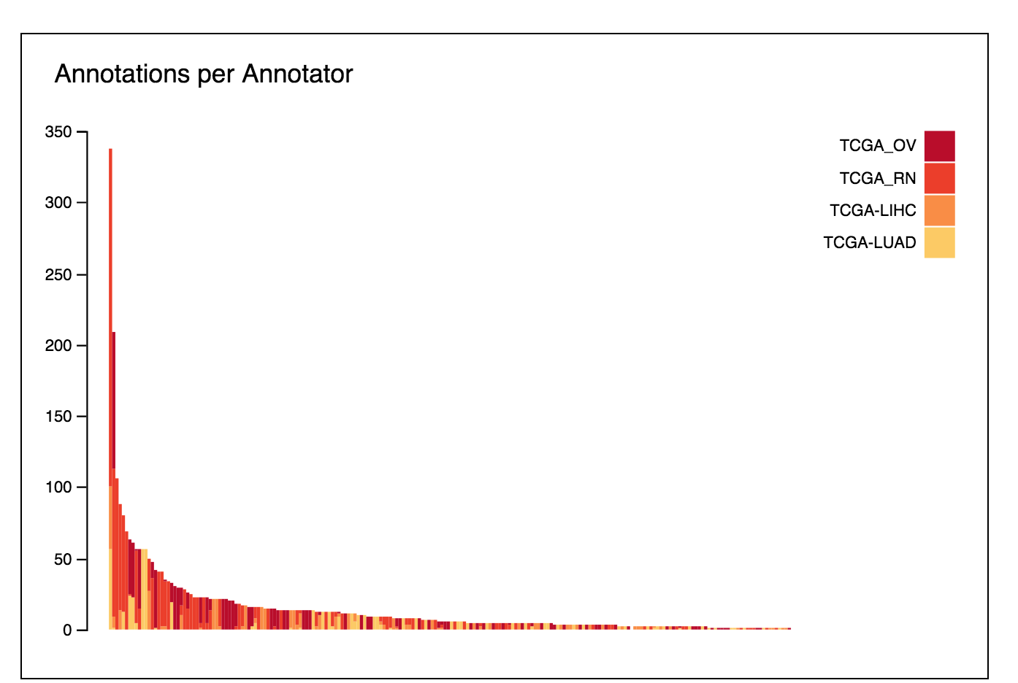
Annotations per annotator
Annotations per annotator
Misty_mandrill clear winner
Nocturnal sparrow catching up!
Rubbery_hamster close behind

Slide 32
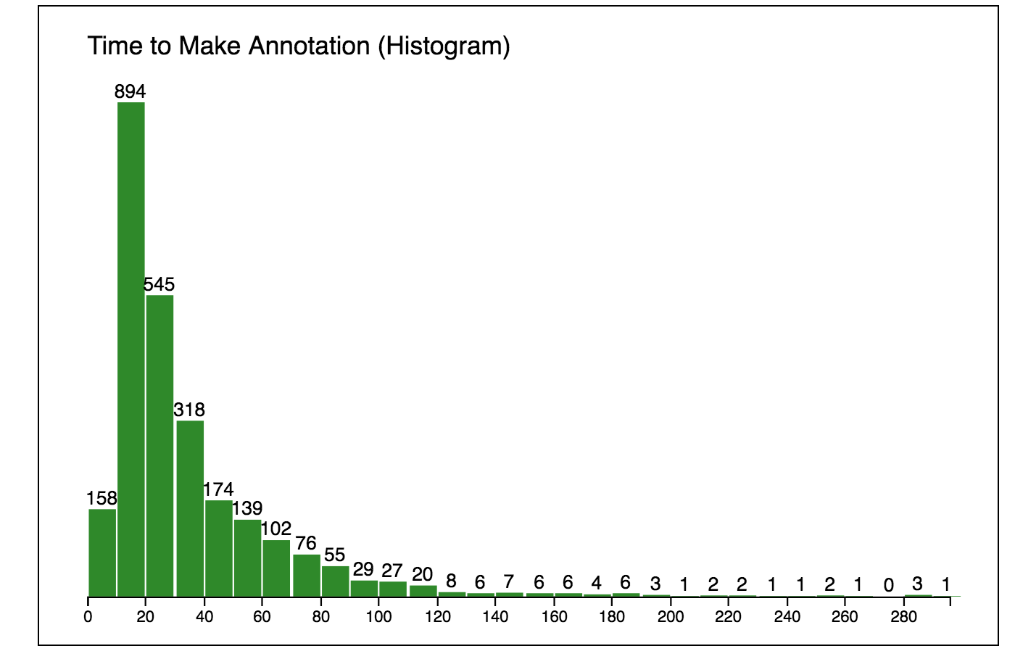
Time it takes to make an annotation
Typically 10-30 seconds

Slide 33
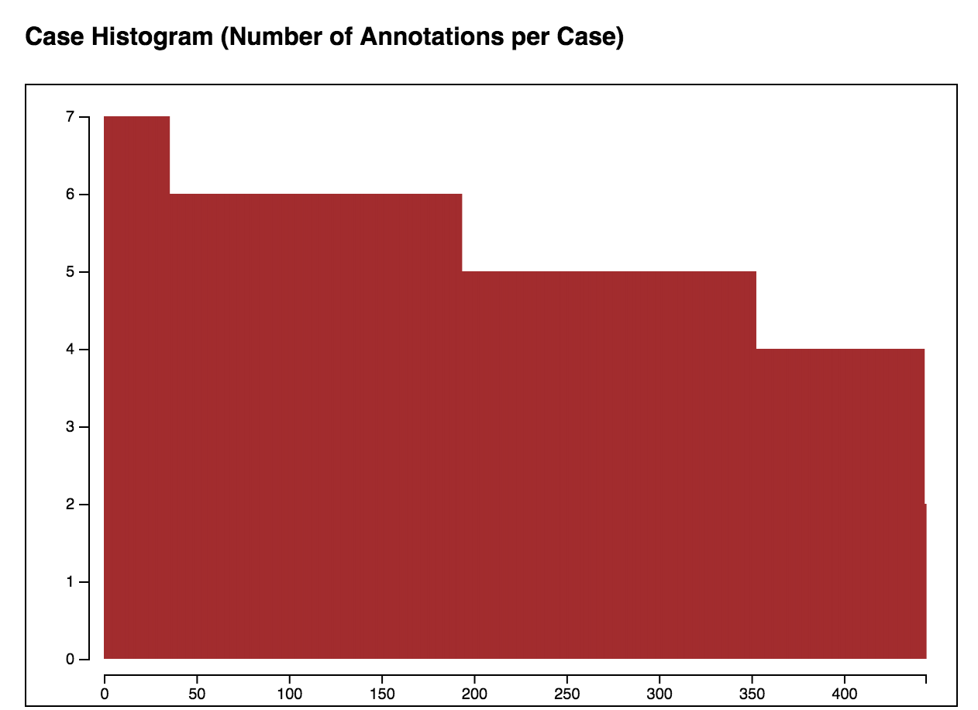
Are we done?

Slide 34
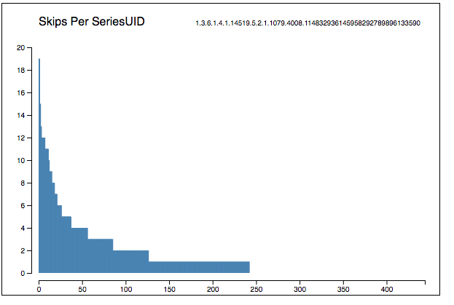
Are some cases more difficult?

Slide 35
Lung results

Slide 36
Feedback on interface
Need to start with a click through tutorial
Window/Level presets
Ability to change category mid session
Also important when multiple cancer types are chosen.
Mobile support?
Flag button for quality with text box for comments
No log in when username is empty
Logout button
Need metrics - time per session, scores per session
People asked to see the number of cases they annotated somewhere on the screen.
Add sagittal and coronal views for measurement accuracy
A few did not like the randomization of the images if they selected 3 or 4 cancer types – they complained about getting a bunch of all liver or all lung cases at a time; and said they would have preferred being given the options of which to do next.
System stalled if images for only one cancer type was selected and all the cases were completed.
Reorder buttons – keep essentials only for mobile
Teaching interface – provide immediate feedback compared to “consensus”?
Key up/down

Slide 37
Features to be added
Annotators by type
Time histogram by type
Update charts to remove skips
Ability to all annotations for each case
screen shots of all annotations
Statistics on variability of measurement
Ability to filter out by type??
Can’t filter out our best annotator (misty_mandrill) but can’t keep in junk?
Filter out by number of cases annotated
If <5, probably just trying to see what it is all about
Compare to ground truth
Add data for all cases
Convert AIM measurements to cornerstone
Length, approximate slice
Ability to overlay all annotations including GT

Slide 38
Potential next steps for system
Permanently linked from TCIA
Road show to various meetings?
(Link to challenge platform)

