Slide 1
3D Slicer user guidelines
Step 1 – Download the “stable” release of 3D Slicer from https://download.slicer.org/

Slide 2
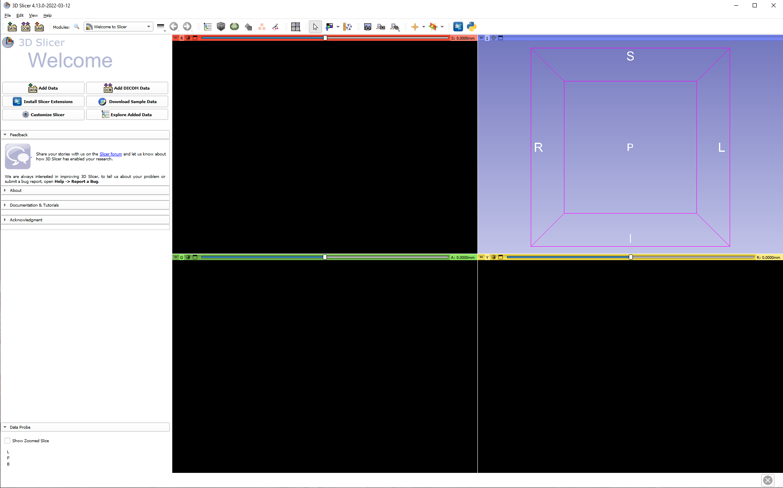
Step 2- Open the application by double clicking on the 3D Slicer icon.

Slide 3
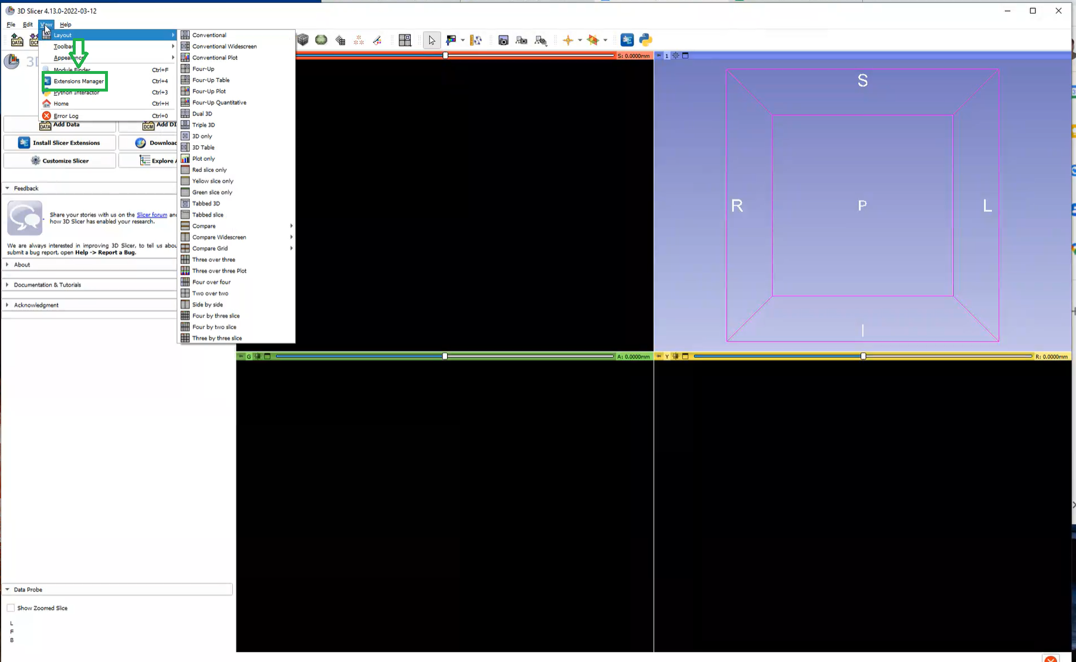
Step 3- Click on the View icon (Green box) and choose the Extension manager in the dropdown menu

Slide 4
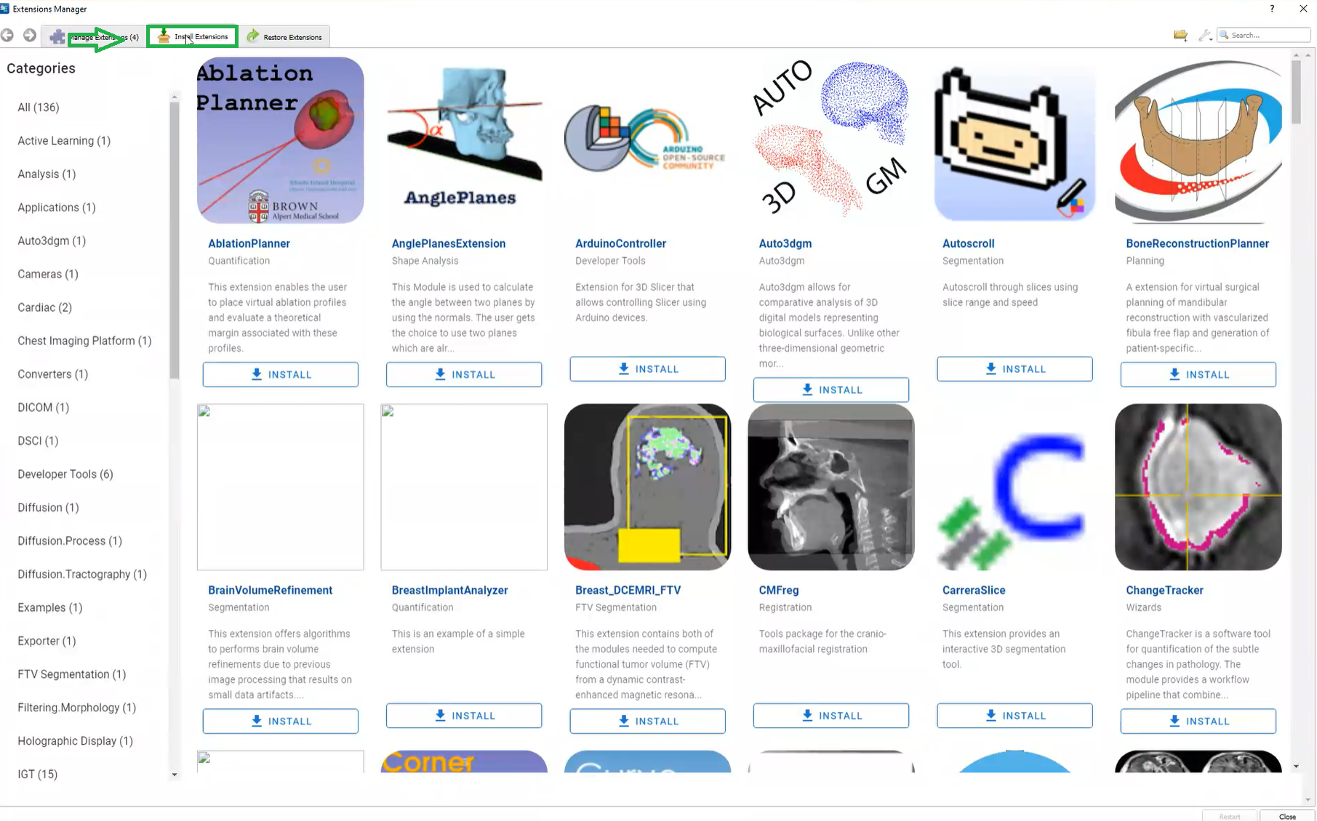
Step 4- Click on the Install Extensions(Greenbox)

Slide 5
Step 5- In the search bar type QuantitativeReporting and Install it

Slide 6
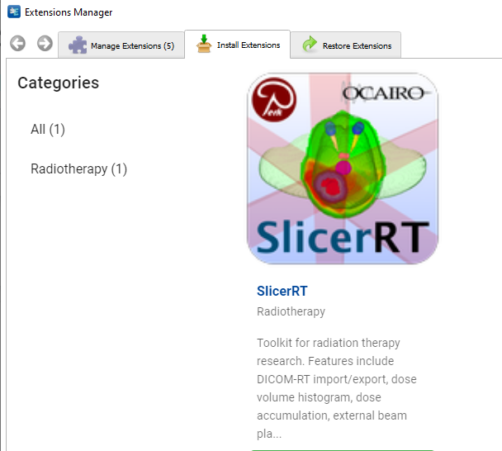
Step 6- In the search bar type SlicerRT and Install it.

Slide 7
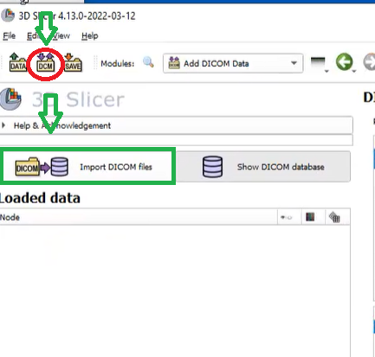
Step 7- Click on the Dicom module (Red circle) and then click import DICOM files(greenbox).

Slide 8
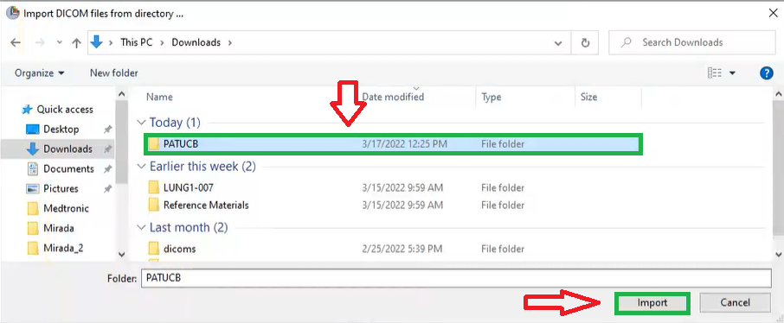
Step 8- Choose the data folder(green box) and click on the import to add DICOM data into the slicer.

Slide 9
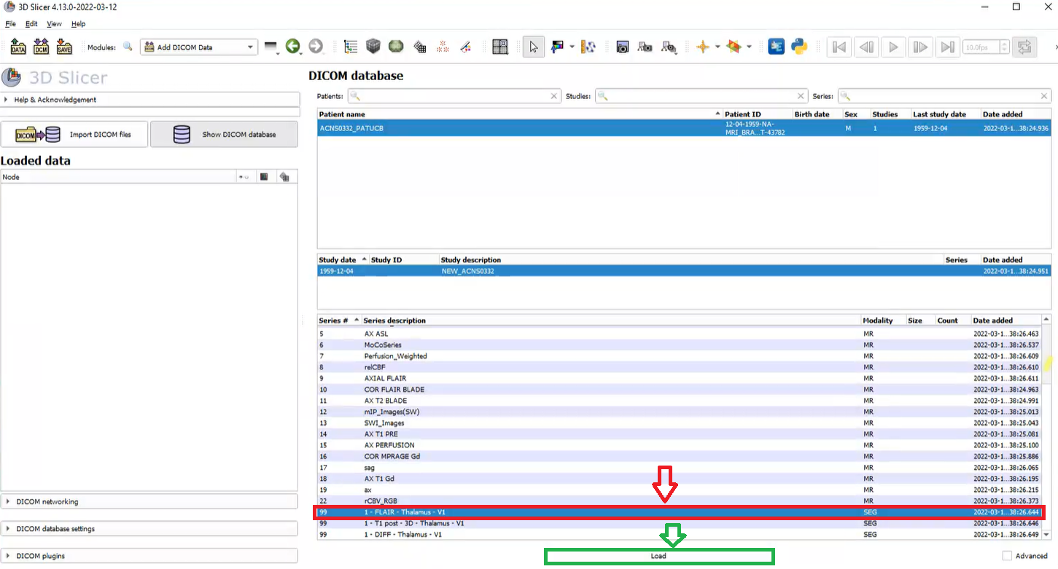
Step 9- To view seg files click on the Dicom seg series (red box) and then click Load.

Slide 10
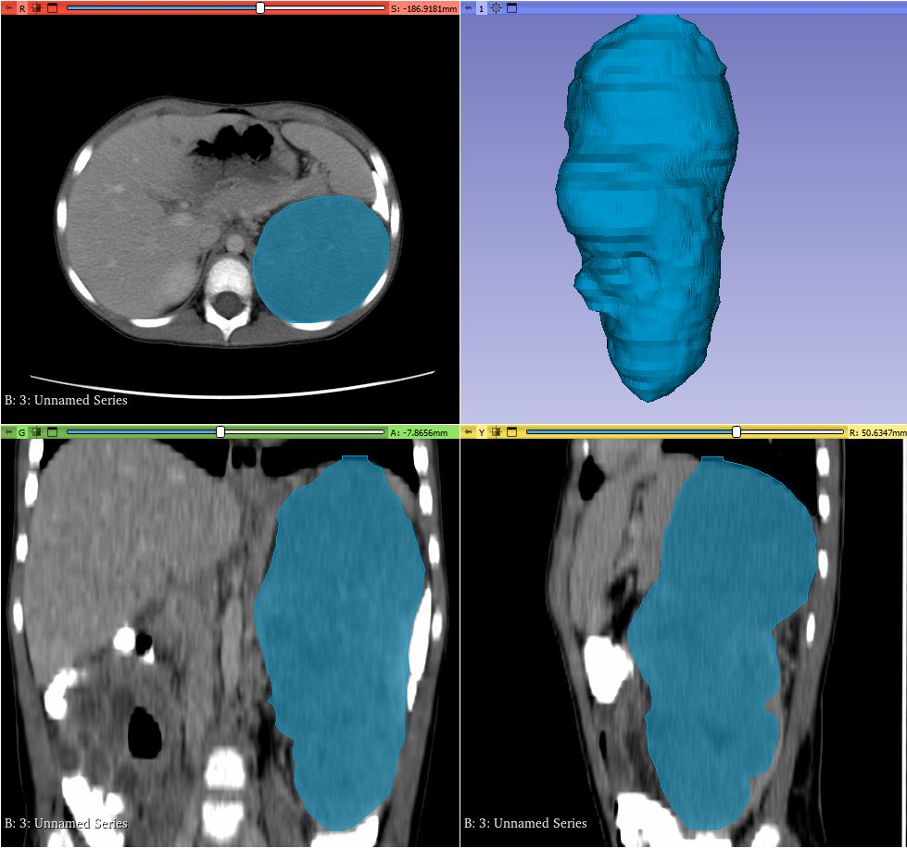
Step 10- Annotations can be viewed in the 3D Slicer screen.

Slide 11
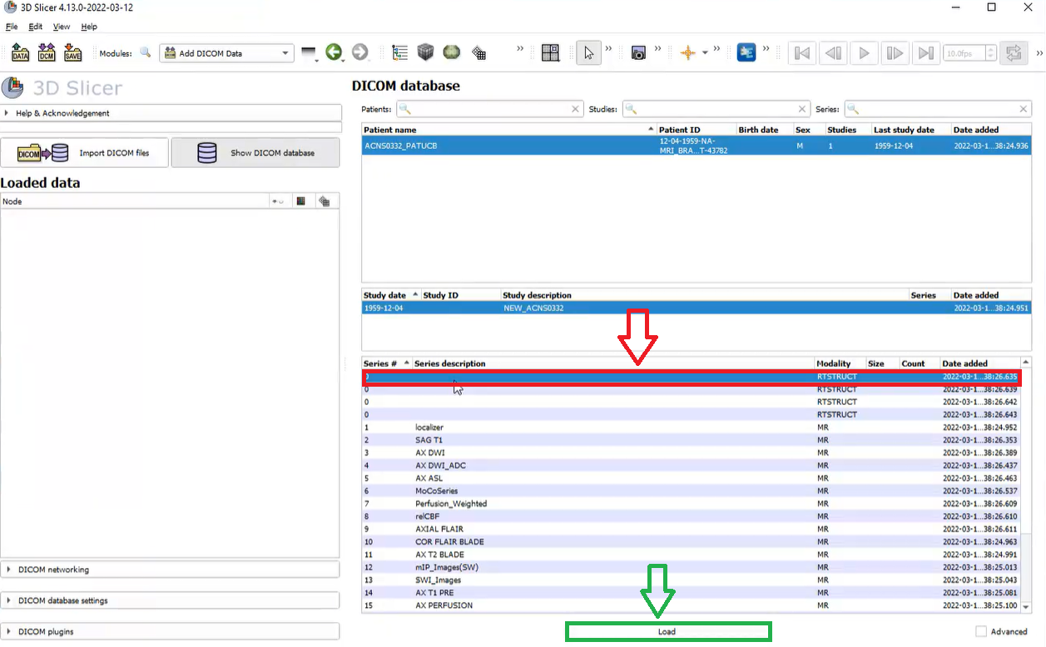
Step 11- To view RTSTRUCT files click on the RTSTRUCT (red box) and then click Load.

Slide 12
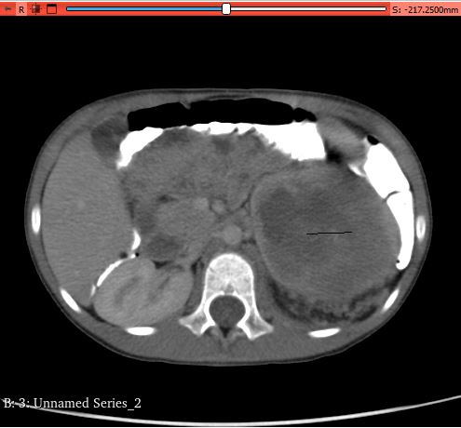
Step 12- RTSTRUCT files can be viewed in the 3D Slicer scan.

Slide 13
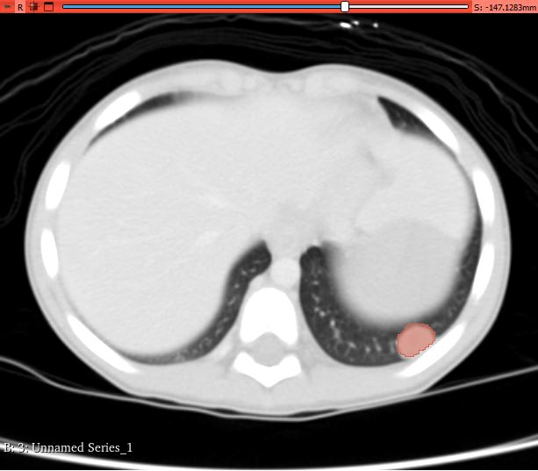
Step 13- Annotations of chest nodules viewed in the 3D Slicer screen

